Slide 1
Alternative Academic Calendar Project Scheduling Classes on a 16-Week Compressed Calendar
JOHN MULLEN, consultant

Slide 2
Alternative Academic Calendar Project FUNDAMENTAL COMMITMENT
Integrity of the Credit Hour
In converting to a compressed calendar, the district must commit to retain the integrity of the credit hour.
In every case, the student must continue to receive the specified number of hours of instruction previously provided under the traditional 35-week academic calendar.
CLPCCD BP and AP 4020 Program, Curriculum, and Course Development

Slide 3
Alternative Academic Calendar Project COURSE OUTLINES OF RECORD
Course outlines remain basically unchanged:
The total hours of instruction and examination required for each course remain the same.
Changes in the length and scheduling of class meetings are needed to meet the hours requirement of individual courses.

Slide 4
Alternative Academic Calendar Project FTES REGULATIONS
The complex rules for FTES calculation remain in force:
All restrictions such as the minimum session length of 50 minutes apply under a compressed calendar.
Detailed guidelines for scheduling classes are available and should be followed to avoid audit exceptions.

Slide 5
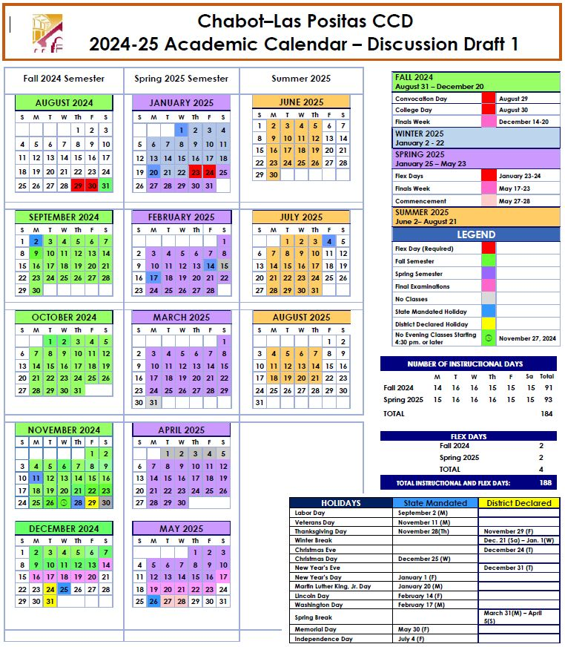
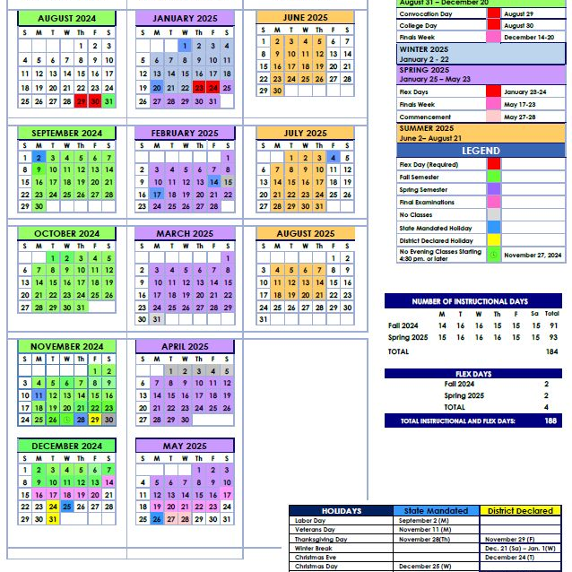
Alternative Academic Calendar Project EXAMPLE DRAFT OF A CLPCCD COMPRESSED ACADEMIC CALENDAR FOR 2024-25

Slide 6
Alternative Academic Calendar Project CLASS SCHEDULING BASICS
The course outline of record states the required hours of instruction for each course:
For example, a 3-unit lecture course typically requires 48-54 of classroom instruction.
To provide for unforeseen meeting cancellations, colleges normally schedule to the range maximum.

Slide 7
Alternative Academic Calendar Project SCHEDULING A 3-UNIT LECTURE COURSE
Scheduling options for a full-semester 3-unit lecture course on the example 16-week calendar:
Two meetings per week of 1 hour and 25 minutes, or
One meeting per week of 3 hours and 10 minutes
On a traditional calendar, course would typically be scheduled with two meetings per week of 1 hour and 15 minutes

Slide 8
Alternative Academic Calendar Project SCHEDULING A 5-UNIT LECTURE/LAB COURSE
Typical schedule for a full-semester 5-unit lecture/lab course on the example 16-week calendar:
Two lecture meetings per week of 1 hour and 25 minutes
Two lab meetings per week of 3 hours and 10 minutes
On a traditional calendar, course would typically be scheduled with two lecture meetings per week of 1 hour and 15 minutes and two lab meetings per week of 2 hours and 50 minutes

Slide 9
Alternative Academic Calendar Project SCHEDULING CATEGORIES
In traditional calendar terminology, most courses fit into categories based on the number of hours per week they meet:
A 3-unit lecture course typically has 3 hours of lecture sessions.
A 5-unit lecture/lab course typically has 3 hours of lecture sessions and 6 hours of lab sessions.
Scheduling options of lecture, lab, and activity sessions are essentially similar -- the number of hours is what counts.

Slide 10
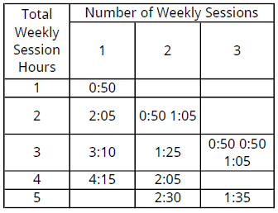
Alternative Academic Calendar Project SCHEDULING CATEGORIES

Slide 11
Alternative Academic Calendar Project Scheduling Classes on a 16-Week Compressed Calendar
JOHN MULLEN, consultant

