Slide 1

25-26 Counseling
Discipline Plan
Joel Gagnon & Cristine Sidela
Student Services Deans
5/2/25

Slide 2


Counseling Discipline Plan - Expectations
Goals and Targets
Optimizing SCFF
Activities & Timelines
Accountability Strategies

Slide 3

Goals and Targets
Student Contact Hour Availability (+ or -)
SEPCs Completion (100%)
Appointment / Drop-in Ratio (70% in GC)
Drop-in students seen / Hour ( 2 – 3 )

Slide 4
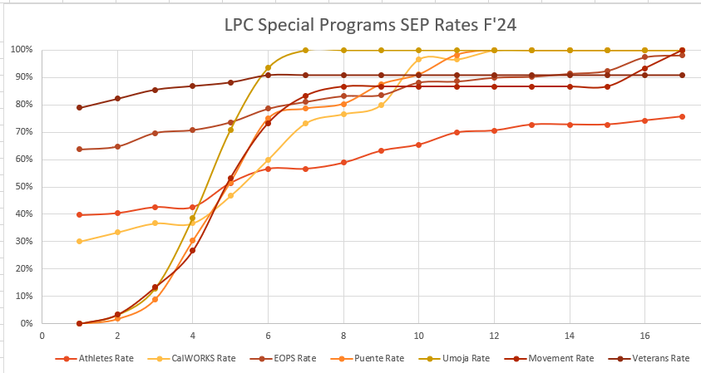
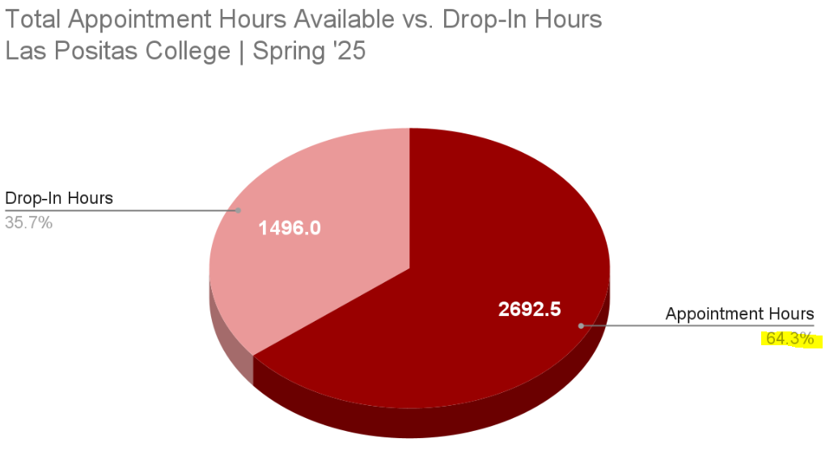
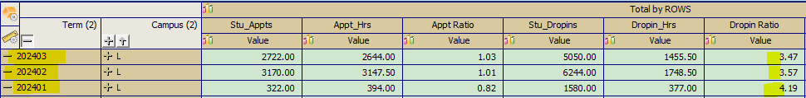
Goals and Targets

Slide 5
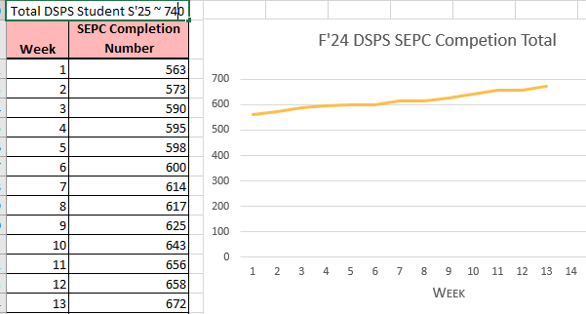
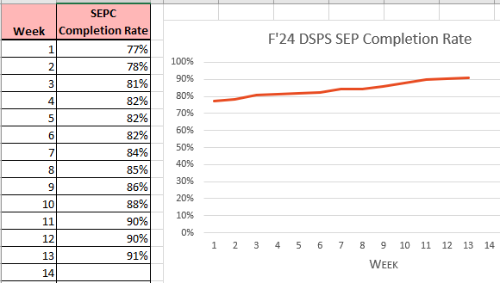
Optomizing SCFF – SEPC Completion (Program)
General Counseling - ~65%
DSPS – 90%
Middle College / MESA - 100%
EOPS/CARE/CalWorks - ~98%
Learning Communities – 100%

Slide 6

Activities and Timelines
  Increase First Semester Planning (FSP) sessions
        Summer FSP Days
        Athletic Eligibility Week
        Operation Gateway (Veterans)
  Prospective Student Counseling (Special Programs)
  New Hawk Day (500+ students Sp’25)

Slide 7
Accountability Strategies
  Data Driven Decisions
          Number of Unfilled appointments
                Drop-in rate (replace with SEPC appts)
  Assigned Drop-in
    Increased # of students/hour
    Known wait times for students
  Data informed overload and part-time allocation

Slide 8

Accountability Strategies
Appointment to Drop-in Ratio
New Student vs Continuing Student SEP
  First-Time SEP vs Follow-up SEP
  SEPC In-Reach
  Counselor Proactive Time
      Email Campaigns
      Call Campaigns
Notes:
Joel explain the work remaining

Slide 9
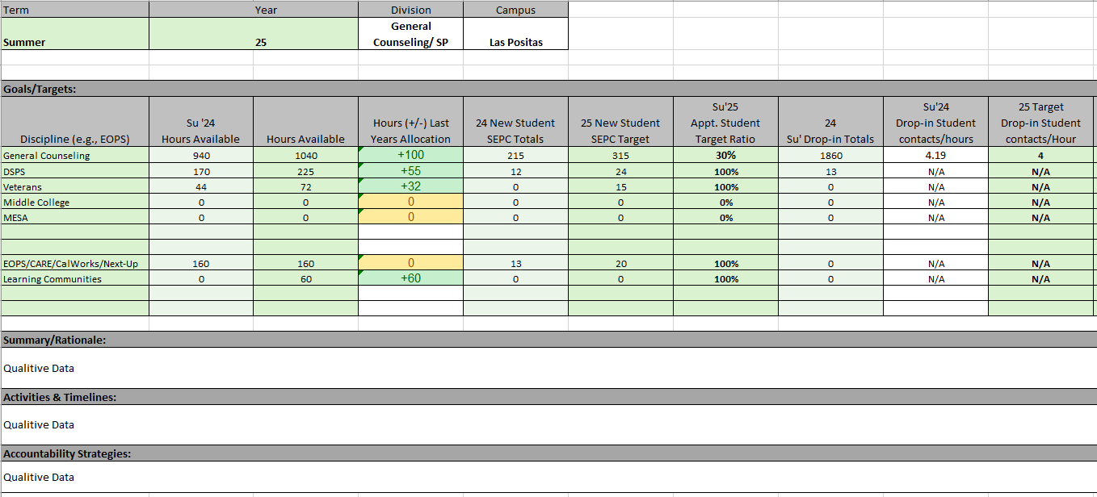
The Discipline Plan

