Slide 1
Zero Waste Initiative – CLPCCD
Implementation Progress Update Summary
Rationale for Zero Waste
Campus Assessment
Key Findings
Training Program
Engagement and Outreach
Infrastructure deployment
Current status
Next Steps
Acknowledgement

Slide 2
Rationale for Zero Waste
• Reduce landfill waste
• Meet sustainability goals
• Lower costs long-term
• Support state mandates
• Engage campus community

Slide 3
Campus Assessment
• All campuses Buildings assessed
• common areas, cafeterias
• Libraries, gyms, conference rooms
• Breakrooms, Outdoor event areas, main entrances to high traffic buildings.

Slide 4
Key Findings
• Inconsistent sorting
• Need for standardized bins
• Training gaps identified
• High compostable waste potential

Slide 5
Training Program
• Led by CA Climate Action Corps Fellow
• Covers rationale, sorting, servicing, data collection.
• Continuous engagement with campus groups

Slide 6
Engagement & Outreach
• Students, faculty, staff involvement
• Workshops and on-site support
• Behavior change focus

Slide 7
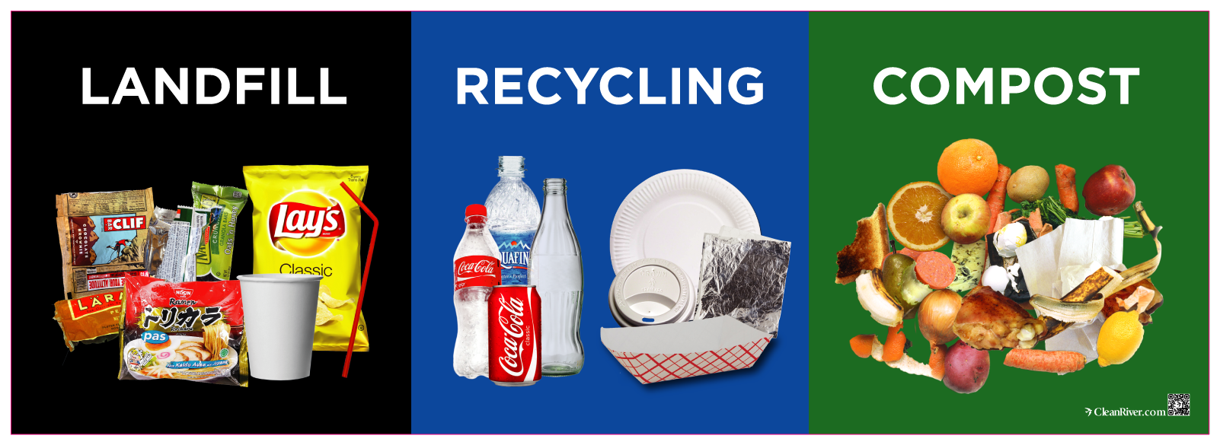
Standardized Waste Streams
Landfill | Recycling | Compost

Slide 8
Infrastructure Deployment
• Bins purchased
• Clearly labeled for accuracy
• Designed for 3-stream sorting

Slide 9
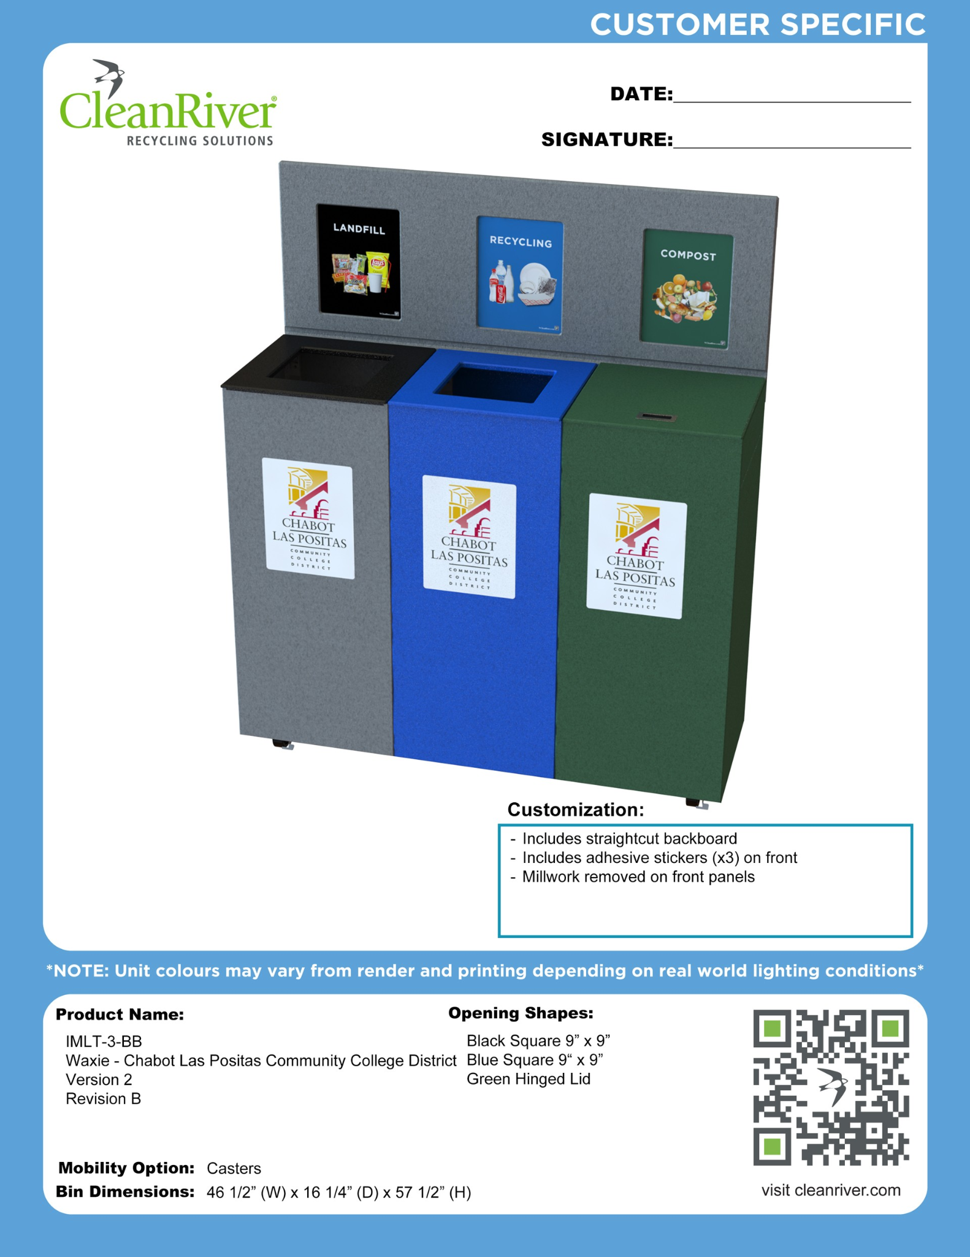
Bin Systems Ready for Rollout

Slide 10
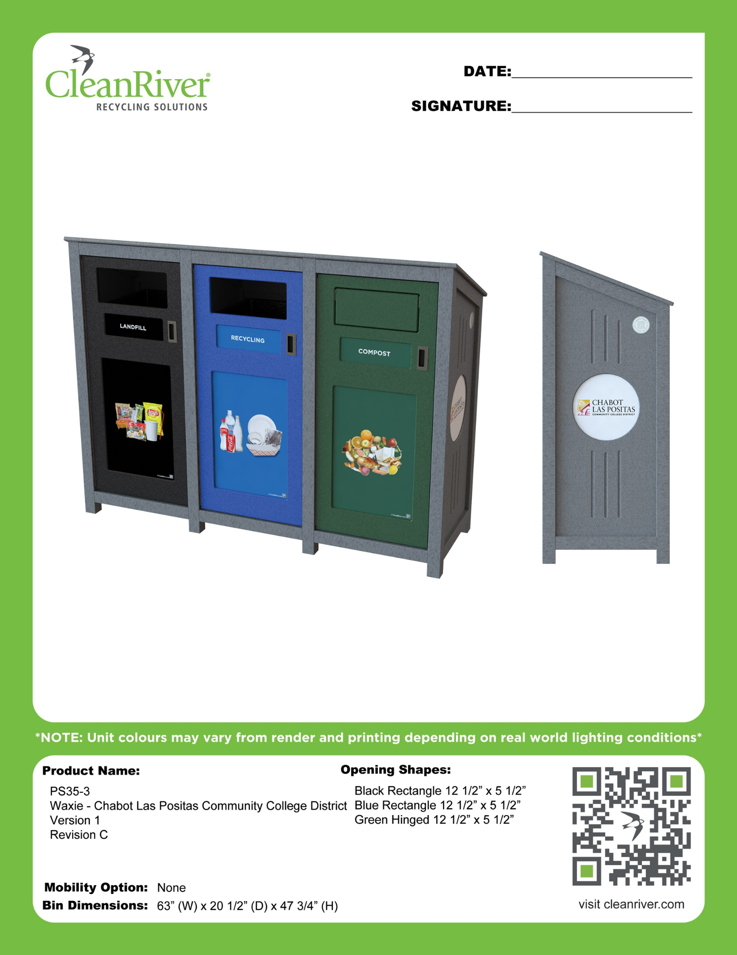
Additional Configurations

Slide 11
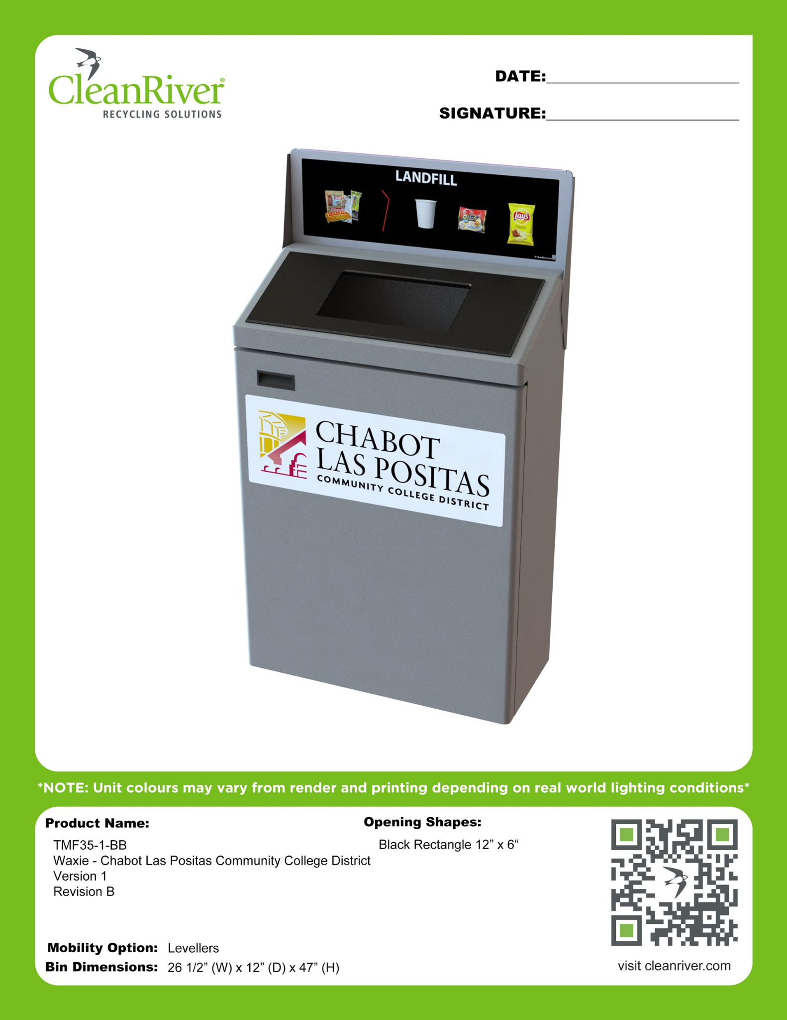
Single Stream Units

Slide 12
Current Status
• Assessment: Completed
• Training: Ongoing
• Engagement: Ongoing
• Bins: Ready for rollout

Slide 13
Next Steps
• Deploy bins across campuses
• Continue training & monitoring
• Track waste diversion data
• Adjust program based on results

Slide 14
Acknowledgements
• Vice Chancellor Owen Letcher – Initiative Owner - leadership and support
• Director John Seybert – guidance and program advancement
California Climate Action Corps Fellows – Training – students, staff and Faculty engagement – Support + Outreach
William Tandongfor - Coordinator of Zero Waste Initiative Implementation.

